Slide 1
Java SE – Week 2
Standard Edition
Notes:
Introduction
Rules
Expectations

Slide 2
Contents page
Debugging
Design Patterns

Slide 3
Course objectives
Describe the layers that most enterprise applications consist of and tools that developers can utilise to make developing enterprise applications simpler without using notes.

Slide 4
Debugging

Slide 5
Debugging
Debugging allows you to run a program interactively while watching the source code and the variables during the execution.
A breakpoint in the source code specifies where the execution of the program should stop during debugging. Once the program is stopped you can investigate variables, for example checking their actual value.
Sometimes we make assumptions that a variable is a particular value, debugging allows us to check exact values during run-time.
Never make assumptions.

Slide 6

Setting Breakpoints
To set a breakpoint, Right Click -> Toggle Breakpoint in margin
You can then run the application with debug using F11.

Slide 7
Controlling the program execution
There are buttons in the toolbar to control debug mode, or:
F5 – Executes the currently selected line, will step into methods.
F6 - Steps over method calls.
F7 – finished the execution of the current method and returns to the caller of the method.
F8 – resume the program until it reaches the end of the program or next breakpoint.

Slide 8
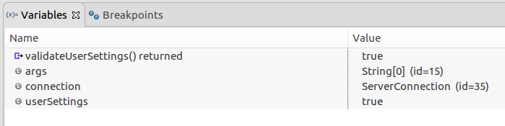
Evaluating Variable Values

Slide 9
Design Patterns

Slide 10
Design Patterns
Design patterns represent the best practices developed and used by experienced OO software developers.
In general they are solutions to common problems that developers faced during development.
Think of them as ‘Templates’ that you can use to make your code more efficient/effective.
Notes:
Represent best practice
Solutions to common problems/issues
Templates for best practice
Thought up by smarter people then me
You don’t need to know them all
Just know they exist
If you encounter a problem you don’t know how to solve, there may be a design pattern for it

Slide 11
Creational
Creational Patterns are centred around the creation of objects while hiding the logic behind the creation. The aim of this is to give the program greater flexibility in deciding which objects are needed for a given case.

Slide 12
Structural
Structural design patterns focus on the way the classes and objects are structured. The aim of this if to use inheritance and interfaces to define the composition of objects for new functionality.

Slide 13
Behavioural
Behavioural patterns are focused on the communication between objects.

Slide 14
Builder Pattern
Builder pattern solves the issue where the amount of parameters that an object requires leads to an exponential amount of constructors
(To enable every combination between the parameters)
How the builder pattern solves this problem is by using default values and being able to return/fill a constructor at every step.
Builder pattern is an object creation software design pattern, intention of it is to find a solution to the telescoping constructor anti-pattern which occurs when the increase of parameters for constructors leads to an exponential list of constructors.
Instead of using numerous constructors the builder pattern uses another object, a builder, that receives each parameters step by step then returns the resulting constructed object at once.
Notes:
Number of constructor increases exponentially
one class with 3,4,5 attributes that grows exponentially
Constructor many values, many Strings, how would you call const with just one, which one would it be, why

Slide 15
Builder Pattern - Example
public class Trainee {
private String name;
private int age;
private String technology;
Trainee(String name, int age, String technology)
{
this.name = name;
this.age = age;
this.technology = technology;
}
}
public class TraineeBuilder {
private String name;
//we dont want a default name.
private int age = 0;
//default age
private String technology = "nothing"; //default technology
public TraineeBuilder(){}
public Trainee buildTrainee()
{
return new Trainee(name,age,technology);
}
public TraineeBuilder name(String _name)
{
this.name = _name;
return this;
}
}
Notes:
What if I added more parameters?
Exponential increase in number of constructors

Slide 16
Builder Pattern - Example
public TraineeBuilder age(int _age)
{
this.age = _age;
return this;
}
public TraineeBuilder technology(String _technology)
{
this.technology = _technology;
return this;
}
Trainee t1 = new TraineeBuilder().name("connor").buildTrainee();
Trainee t2 = new TraineeBuilder().name("jeff").age(12).technology("devops").buildTrainee();
Notes:
So here we get a really tidy oneliner that basically lets you put as many or as little parameters as you want to use for that object, in the first example we just give it a name and in the second we fill everything in
How this works is that when we create our trainee builder, after the brackets we can then call the method name() which returns the traineebuilder, so then on that instance of trainee builder we can call the method age() and so forth, until we want it to return type of Trainee which we then call buildTrainee() and that is the object that is assigned to “t2” in this case, our trainee.
Called method chaining
Effively these methods are setters

Slide 17
Other Patterns
Creational
Structural
Behavioural
Factory Pattern
Builder Pattern
Singleton Pattern
Prototype Pattern
Abstract Factory Pattern
Flyweight Pattern
Adapter Pattern
Composite Pattern
Decorator Pattern
Façade Pattern
Proxy Pattern
Bridge Pattern
Filter Pattern
Chain of Responsibility Pattern
State Pattern
Observer Pattern
Interpreter Pattern
Iterator Pattern
Mediator Pattern
Memento Pattern
Null Object Pattern
Strategy Pattern
Template Pattern
Visitor Pattern
Notes:
Know how to research and implement them if when you are deployed you are asked to follow a particular pattern

Slide 18
Singleton Design Pattern
It is important that you can understand and use the Singleton design pattern.
If you have not already you should complete the Singleton design Pattern Exercise from the workbook.

Slide 19
Exceptions
Notes:
Remember Printer Example

Slide 20
Exceptions
An exception is something that occurs during the execution of a program that disrupts the normal flow of instructions.
Every system is going to have errors that occur at some point, Error handling is the way in which we prevent the system from terminating unexpectedly, aka handling the errors in a desirable way.
There are 2 different type of exceptions
Checked – An exception that is noticed by the compiler
Unchecked – An exception that isn’t noticed by the compiler.
Notes:
- Printer example
It is an exceptional circumstance
- concurrent modification
Null pointer exception
arrayindexoutofbounds

Slide 21
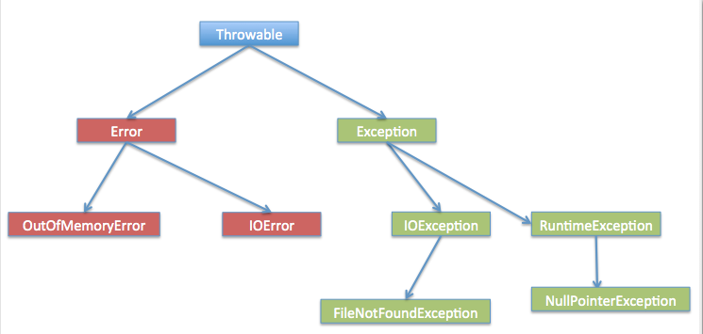
Exception Hierarchy
Notes:
You have to be able to explain exceptions without using the word errors, they are different things.

Slide 22
Checked Exceptions
Compile time
Where we can anticipate an exception ahead of time and plan for it
Exception is the parent class of all Checked Exceptions
FileNotFoundException
SocketException
UnsupportedDataTypeException
ClassNotFoundException
NoSuchMethodException
NoSuchFieldException
Notes:
https://docs.oracle.com/javase/7/docs/api/java/io/IOException.html

Slide 23
UnChecked Exceptions
Runtime issues (When the code is being ran)
Caused by bad programming
E.g. trying to address an array at a point that is larger than the arrays size
RuntimeException is the parent class of all unchecked exceptions.
If we are throwing a RuntimeException (or any subclass of it) in a method, it’s not required to specify them in the signatures throw clause.
ArrayIndexOutOfBoundsException
ClassCastException
NullPointerException
NumberFormatException
IllegalArgumentException
Notes:
http://docs.oracle.com/javase/7/docs/api/java/lang/RuntimeException.html

Slide 24
Errors
Subclass of Throwable.
Indicates a serious problem that an application should not try to catch
VirtualMachineError
ThreadDeath
OutOfMemoryError
CoderMalfunctionError
Notes:
http://java.sun.com/javase/6/docs/api/java/lang/Error.html

Slide 25
Handling Exceptions
You can have
Catch and no finally.
Catch with a finally.
Multiple catches and no finally.
Multiple catches with a finally.
try {
// The System will try to run this // code
} catch(ExceptionType name) {
// If an exception occurs in the try // block that matches the // ExceptionType of the catch // statement, this block will run
} finally {
// This is code that will always run // regardless of whether or not an // exception was thrown
}
Notes:
Work an example
Arithmetic exception example

Slide 26
Handling Exceptions - Example
You can use multiple catch statements to handle specific exceptions.
Be careful when doing this as the compiler will throw an exception for unreachable code if you try to catch an exception that has already been caught by a previous catch.
} catch (InputMismatchException imx) {
// TODO: handle exception
} catch (IOException ioe) {
// TODO: handle exception
} catch (Exception e) {
// TODO: handle exception
}

Slide 27
Handling Exceptions– Further Example
This method is designed to take an integer off a user.
sc.nextInt(); will throw a “InputMismatchException” if they enter something that isn’t an integer
So we can surround this in a try/catch block to handle that error
int takeInput(){
Scanner sc = new Scanner(System.in);
int input = -1;
try{
input = sc.nextInt();
}catch(InputMismatchException ime){
System.out.println(ime.toString());
}
return input;
}

Slide 28
The Throws Clause
If a Checked exception is thrown in a method, whatever is calling that method must handle it in some way.
One way is to surround it with a try/catch
Another way is to add another throws clause onto the method.
“method2” in this case could be a method inside of an IO Class that expects an IOException to be thrown, and thus needs to be handled.
public static void main(String[] args) {
method1();
}
static void method1() {
method2();
}
static void method2() {
throw new IOException();}
Notes:
In this example the error will be in method2 saying that an exception isn’t being handled.

Slide 29
Working with errors
public static void main(String[] args){
method1();
}
static void method1() {
method2();
}
static void method2() throws IOException {
throw new IOException();
}
public static void main(String[] args) {
method1();
}
static void method1() throws IOException {
method2();
}
static void method2() throws IOException {
throw new IOException();
}
Notes:
First example error will be in method1() on the method2() call saying an exception is unhandled
Second example will be an error in main on the method1() call saying an exception is unhandled.

Slide 30
Working with errors
public static void main(String[] args) throws IOException {
method1();
}
static void method1() throws IOException {
method2();
}
static void method2() throws IOException {
throw new IOException();
}
public static void main(String[] args) {
try {
method1();
} catch (IOException io) {
System.out.println(io.toString());
}
Notes:
Both examples will compile however in the first example the error will never be handled/caught, whilst in the second it will be.

Slide 31
Try-with-resources Statement
It is a try statement which declares one or more resources.
The resource is an object that must be closed after the program is finished with it.
The resource is declared within the parenthesis after try.
Because the BufferedReader instance is declared in a try-with-resource statement, it will be closed regardless of whether the try statement completes normally or abruptly
public String readFirstLine(String path) throws IOException
{
try (BufferedReader br =
new BufferedReader(
new FileReader(path))) {
return br.readLine();
}
}
Notes:
A class can be a resource if it implements AutoCloseable from the java.lang library or Closeable from java.io library, it can be used as a resource.
Try with resources makes code much easier to read.
Compare the two ways of opening, using and reading from the file:
Using try-with-resources
try (BufferedReader br = new BufferedReader( new FileReader(path))) {
return br.readLine();
}
Without using try-with-resources
BufferedReader br = new BufferedReader( new FileReader(path));
try {
return br.readLine();
} finally {
if (br != null) {
br.close();
}
}

Slide 32
Exceptions & Inheritance - Rules
An overriding method (sub/child) can throw any unchecked exceptions, regardless of whether the overridden method (super/parent) throws exceptions or not.
However the overriding method (sub/child) should not throw checked exceptions that are new or broader than the ones declared by the overridden method (super/parent)
The overriding method (sub/child) can throw those checked exceptions which have less scope than the exceptions declared in the overridden method (super/parent)
If a constructor is throwing an exception then any subclasses of that class must also throw the same Exception.
Notes:
Introduce the idea of a stack
LIFO
Generally about functions
Worked example arithmetic is good
Just show it working
Pretty simple really
Show with and without finally
Copy across into Visual Studio Code
This keeps the code format.
public static void main(String[] args) {
// TODO Auto-generated method stub
System.out.println(divideNum(2, 0));
}
public static int divideNum(int a, int b) {
int c = 0;
try {
c = a / b;
return 1;
} catch (ArithmeticException ex) {
return 2;
} finally {
}
}
​

Slide 33
SOLID Principles

Slide 34
Symptoms of bad code
Rigidity – changes to one part affect many other parts
Fragility – things break in unrelated places
Immobility – Cant reuse code outside of its initial context
Notes:
Best practice for designing your classes

Slide 35
SOLID Principles
Introduced by Uncle Bob
Too much Dependency happening (Spaghetti Code)
SOLID helps you write your code with future use in mind, not just your immediate needs.
Notes:
Best practice for designing your classes

Slide 36
SOLID
The five basic principles of Object Orientated Programming/Design
Following these will make your system easier to maintain and extend over time.
Part of an overall strategy of agile and Adaptive software Development
Single Responsibility Design
Open/Closed Principle
Liskovs Substitution Principle
Interface Segregation Principle
Dependency inversion Principle
Notes:
Best practice for designing your classes

Slide 37
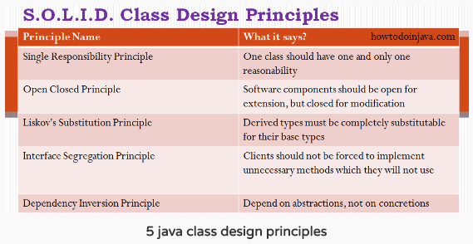

Slide 38
JUnit

Slide 39
Testing
Testing is Highly Important.
Within Testing we have Methods, Levels, Types and Methodologies.
Methods include White-Box and Black-Box Testing.
Levels include Unit and Acceptance Testing.
Types include Functional and Non-Functional
Methodologies include Top-Down and Bottom-Up.
In Test Driven Development you Test First, Code Later.
Unless a test fails, you don’t code.
If no test fails, write more tests.
The result is that all code is covered by tests.
All code conforms to the design specification and
Problems are caught sooner and fixed cheaper.

Slide 40
Unit Testing
Unit testing is all about ensuring that a specific piece of code works.
To do this you create Test Classes.
Test Classes hold all of the tests for a specific class and are in charge of setting up and tearing down the class and any other classes that are required to test the class in question.
Test Classes are run from a Test Suite class.
Junit is what we’ll be using for our Unit tests.

Slide 41
JUnit Test Methods
assertTrue(“Boolean was False”, Boolean)
assertFalse(“Boolean was True”, Boolean)
assertEquals(“Actual was not Expected”, Expected, Actual)
assertEquals(“Actual was not expected within the Tolerance”, Expected, Actual, Tolerance)
fail(“Method Failed the Test”)
assertNull(“The object is not Null”, Object)
assertNotNull(“The object is Null”, Object)
assertSame(“The objects are not the same”, Expected, Actual)
assertNotSame(“The objects not the same”, Expected, Actual)
Notes:
So the message here is what the test should print out when the test fails

Slide 42
JUnit
Junit might be already installed on your system, if not search for Junit download 4.0.
Once you have access to the .jar file, go to your project, right click -> properties -> java build path -> libraries -> add external jar, then add your junit jar file.
Once installed simply create a ‘junit test case’.
I’d advise having all your tests in a separate package, naming your tests after the class they’re testing.
import static org.junit.Assert.*;
import org.junit.Test;
public class AuthorTest {
@Test public void testAuthor() {
Author testing = new Author();
assertNull(testing.getName());
}
@Test public void testAuthorString() {
Author testing = new Author("a");
assertNotNull(testing.getName());
}
@Test public void testSetName() {
Author testing = new Author();
testing.setName("a");
assertEquals("a", testing.getName());
}

Slide 43
IO

Slide 44
java.IO
IO = Input/Output
Java refers to IO as a ‘stream’
An IO stream represents an input source or an output destination
A stream can represent different kinds of sources and destinations
Files, devices
Other Programs
Memory Arrays
Websites
Streams can support many different types of data.
Primitive data types
Strings
Streams simply pass on data, or manipulate/transform the data into different types of data.
E.g. you could read in bytes from a file but then process it as a String, then write it back as bytes.

Slide 45
The two main categories of data streams
A developer typically uses input and output in 3 ways
To interact with files and directories
To read from and write to the console (Standard-in and Standard-out)
Using ‘socket’ based sources to communicate with a remote system
Base class names (you use classes that derive from these)
For byte streams – InputStream & OutputStream
For character streams – Reader & Writer
Java supports two types of streams: character and byte.
‘Readers’ and ‘Writers’ handle ‘character’ data.
Input & Output streams handle ‘byte’ data
Typically we say stream to refer to a byte stream.
Say reader and writer to refer to (Unicode) character streams.

Slide 46
Byte Stream - Example
This simple example copies the contents of one file to another file just using a byte array 128 at a time.
Then the odd few at the end (assuming total length of bytes read in is not an exact multiple of 128).
import java.io.*;
public static void copy(String inFile, String outFile) throws IOException {
byte[] bytes = new byte[128];
FileInputStream fis = new FileInputStream(inFile);
FileOutputStream fos = new FileOutputStream(outFile);
int count = 0, read = 0;
while ((read = fis.read(bytes)) != -1) {
fos.write(b, 0, read); // mainly 128 at a time
count += read;
}
System.out.printf("Wrote: %d bytes\n ", count);
fis.close();
fos.close();
}

Slide 47
Buffered Reader - Example
BufferedReader chained to a FileReader but notice the read requests issued to the high level BufferedReader, mirrored by the BufferedWriter using the FileWriter.
public static void bufferedcopy(String inFile, String outFile) throws IOException
{
BufferedReader bfrIn = new BufferedReader(new FileReader(inFile));
BufferedWriter bfwOut = new BufferedWriter(new FileWriter(outFile));
String line = "";
while ((line = bfrIn.readLine()) != null) {
bfwOut.write(line + "\n");
}
bfrIn.close();
bfwOut.close();
}

Slide 48
Generics And Collections

Slide 49
Generics
Generics add stability to your code by making more bugs detectable at compile time.
If we have a method that takes an Object it will accept everything except a primitive. If at the end we cast the Object to an Integer and we are passing in a String then we get a runtime exception.
If we provide a type <T> then we allow the compiler to check for that type.
public class Cage<T>
{
private T object;
public void add(T object)
{
this.object = object;
}
public T get()
{
return object;
}
}
Notes:
In this example Cage could be a Cage for a Bird, or a Lion, make it work with whatever its presented with.

Slide 50
ArrayDeque
also known as an “Array Double Ended Queue”, pronounced as “ArrayDeck”
is a special kind of a growable array that allows us to add or remove an element from both sides.
Can be used as a stack or a queue
Notes on Deque
Null elements are not accepted
Works significantly faster than the synchronized Stack
Is a faster queue than LinkedList due to the better locality of reference
An Iterator returned by an ArrayDeque is fail-fast
ArrayDeque automatically doubles the size of an array when head and tail pointer meets each other while adding an element

Slide 51
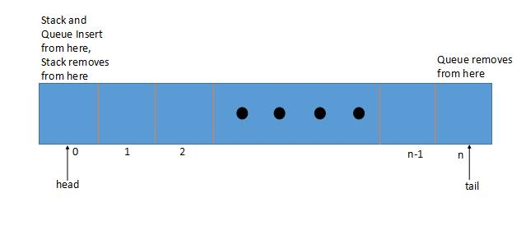
ArrayDeque

Slide 52
Comparisons
Comparable is an interface defining a strategy of comparing an object with other objects of the same type. This is called the class’s “natural ordering”.
In order to be able to sort – we must define our Player object as comparable by implementing the Comparable interface:
The sorting order is decided by the return value of the compareTo() method.
The method returns a number indicating whether the object being compared is less than, equal to or greater than the object being passed as an argument.

Slide 53
Comparators
Firstly we create a class that implements our Comparator Interface.
This class we need the override the compare(arg1,arg2) method

Slide 54
Comparator Vs Comparable
The Comparable interface is a good choice when used for defining the default ordering or, in other words, if it’s the main way of comparing objects.
Sometimes, we can’t modify the source code of the class whose objects we want to sort, thus making the use of Comparable impossible
Using Comparators allows us to avoid adding additional code to our domain classes
We can define multiple different comparison strategies which isn’t possible when using Comparable

Slide 55
Optionals

Slide 56
Optionals
The main issue this class is intended to tackle is the infamous NullPointerException
Essentially, this is a wrapper class that contains an optional value, meaning it can either contain an object or it can simply be empty.
Optional should be used mostly as the return type of functions that might not return a value.
A Practical example of the benefit of Optionals would be when interfacing with a Database.

Slide 57
Problem
Imagine a Person Class with 3 attributes (e.g. age, name, address)
If we had multiple Constructors for this class and had not set default values for each attribute.
It is possible that we can create a Person that has no ‘address’ value.
P1.getAddress()
NULLPOINTEREXCEPTION

Slide 58
Optional Examples
// Optional.ofNullable - allows passed parameter to be null.
Optional<Integer> a = Optional.ofNullable(value1);
// Optional.of - throws NullPointerException if passed parameter is null
Optional<Integer> b = Optional.of(value2);

Slide 59
Optional Examples
Integer a = null;
Integer b = 0;
If (a != null && b != null){
System.out.println(a+b);
}else if{a == null){
System.out.println(10+b);
} else if{b == null){
System.out.println(a+10);
} else {
System.out.println(10+10);
}
Integer a = null;
Integer b = 0;
Optional<Integer> optA = Optional.ofNullable(a);
Optional<Integer> optB = Optional.ofNullable(b);
System.out.println(optB.orElse(3) + optA.orElse(3));

Slide 60
JDBC

Slide 61
JDBC
The JDBC API allows us to connect to SQL databases from our Java applications.
Using a JDBC driver, with the location of the database and the credentials for accessing that database we can query the database for data and perform the CRUD functions.
public class JDBCExample
{
static final String JDBC_DRIVER = "com.mysql.jdbc.Driver";
static final String DB_URL = "jdbc:mysql://localhost/dbexample";
static final String USER = "username";
static final String PASS = "password";

Slide 62
Opening a connection
The first thing we need to do is open the connection to the database.
public void accessDB() {
Connection conn = null;
Statement stmt = null;
…
Class.forName(“com.mysql.jdbc.Driver”);
System.out.println(“Connecting to database...”);
conn = DriverManager.getConnection(DB_URL, USER, PASS);
…

Slide 63
C - Create
This block of code will create a new entry into the table Languages using the connection we opened earlier.
First it will create a statement,
Then it will take the SQL query as a String.
Finally it will Execute that query.
System.out.println(“Inserting records into the table...”);
stmt = conn.createStatement();
String sql = “INSERT INTO Languages “ + “VALUES (1, 'Java', 1992)”;
stmt.executeUpdate(sql);
System.out.println(“Inserted records into the table...”);

Slide 64
R - Read
System.out.println("Creating statement...");
stmt = conn.createStatement();
String sql2 = "SELECT id, name, date FROM Languages";
ResultSet rs = stmt.executeQuery(sql2);
while (rs.next()) {
int id = rs.getInt("id");
String name = rs.getString("name");
int date = rs.getInt("date");
System.out.println("ID: " + id + ", name: " + name + ", date: " + date);
}
rs.close();
Notes:
This block of code will read all entries in the table Languages using the connection we opened earlier and print the results.
First it will create a statement,
Then it will take the SQL query as a String.
After that it will Execute that query.
Finally it will loop through all results, printing them to the console.

Slide 65
U - Update
This block of code will update an existing entry in the table Languages using the connection we opened earlier.
First it will create a statement,
Then it will take the SQL query as a String.
Finally it will Execute that query.
System.out.println(“Creating statement...”);
stmt = conn.createStatement();
String sql3 = “UPDATE Languages “ + “SET date = 1994 WHERE id in (1, 2)”;
stmt.executeUpdate(sql3);

Slide 66
D - Delete
This block of code will delete an entry in the table Languages using the connection we opened earlier.
Be careful with the delete operation as you can easily delete the wrong entry by mistake.
First it will create a statement,
Then it will take the SQL query as a String.
Finally it will Execute that query.
System.out.println(“Creating statement...”);
stmt = conn.createStatement();
String sql4 = “DELETE FROM Languages ” + “WHERE id = 1”;
stmt.executeUpdate(sql4);

Slide 67
Closing the connection
The last thing we need to do is close the connection to the database.
We will catch all of the exceptions that may be thrown.
We will then check that the connections are open and if so, close them.
} catch (SQLException sqle) {
sqle.printStackTrace();
} catch (Exception e) {
e.printStackTrace();
} finally {
try {
if (stmt != null)
conn.close();
} catch (SQLException se) { }
try {
if (conn != null)
conn.close();
} catch (SQLException se) {
se.printStackTrace();
}
}
System.out.println(“Goodbye!”);

Slide 68
Logging
Logging is used to keep a history of system related messages during the operation of a system.
The Java.util.Logging package contains the classes associated with logging including the Level class which is used to define the lowest severity of messages which should be written to the log.
The Levels of severity are:
Severe – The world is ending
Warning – Mild Panic
Info – Things you may need to know
Config – Deployment information
Fine – Debugging information
Finer – Things you may need to know
Finest – Nitty-gritty details

Slide 69
Logging - Handlers
Loggers work by utilising handlers to output their data in the appropriate location.
You can also create your own handlers from scratch or even just re-write some of the existing ones to better suit your application.
The Types of Handlers are:
StreamHandler: A simple handler for writing formatted records to an OutputStream.
ConsoleHandler: A simple handler for writing formatted records to System.err
FileHandler: A handler that writes formatted log records either to a single file, or to a set of rotating log files.
SocketHandler: A handler that writes formatted log records to remote TCP ports.
MemoryHandler: A handler that buffers log records in memory.

Slide 70
Logging - Formatters
Loggers output according to formatters that are applied to them.
Java SE provides two standard Formatters
Like with handlers, you can develop your own formatters easily.
The Types of Formatters are:
SimpleFormatter: Writes brief "human-readable" summaries of log records.
XMLFormatter: Writes detailed XML-structured information.

Slide 71
Logging - Example
public class testLog {
private static Logger logger = Logger.getLogger(testLog.class.getName());
public void SomeMethod(){
FileHandler fh;
try {
//create a file handler with a text path
fh = new FileHandler("mylog.txt");
//Assign it a simple formatter (or xml, or custom)
fh.setFormatter(new SimpleFormatter());
logger.addHandler(fh);
//set the level at what you want it to output at.
//could be 'ALL' if you wanted to output everything
logger.setLevel(Level.FINE);
logger.log(Level.FINE, "Cool stuff");
//Does the same as the previous line
logger.fine("Cool Stuff");
} catch (Exception e) {
logger.severe("Error!!" + e.toString());
}
Each class will need its own logger as the level of granularity needed in the logs will change from class to class.
Typically a static Logger will be created in each class as each instance will use the same logger.

Slide 72
Enums
Enumerated types are used as a clean way of storing data that has a finite number of valid values.
Enums should be defined in their own file to allow reuse across your application.
public enum Day {
MONDAY, TUESDAY, WEDNESDAY, THURSDAY, FRIDAY, SATURDAY, SUNDAY
}
----------------------------------------
public void ExampleMethod
{
Day day = Day.FRIDAY;
if(day == Day.FRIDAY){
//its friday!
}
}
Notes:
If I use “west” to denote going west in Barren Moor, it was easier to make a mistake then if I had used Day.WEST
increase compile-time checking
avoid errors from passing in invalid constants

Slide 73
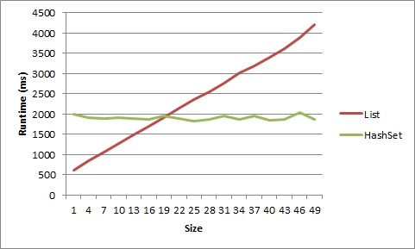
HashMaps/Hashset
HashMaps are an alternative to Normal Collections such as List implementations
Generally much faster
Necessary when you’re searching for elements a lot with LOTS of data
Unorganised
Awkward to iterate through, designed for searching for something that you know what your looking for.
A map will ‘map’ one key to a value
You will give it a key and ask for value
Notes:
A map will ‘map’ one key to a value
You will give it a key and ask for value
Get me the object that is associated with the object
Insane performance increase
- list has a linear performance decrease
- Hashmap has effectively got a constant speed

Slide 74
Hashmaps – Code example
HashMap<Integer, String> map = new HashMap<>();
map.put(1, "Elliott");
map.put(2, "Gareth");
map.put(12, "Dev");
System.out.println(map.get(1)); // elliott
System.out.println(map.get(11)); // null
map.put(1, "Jeff");
System.out.println(map.get(1));// jeff
Iterator<Entry<Integer, String>> it = map.entrySet().iterator();
while (it.hasNext()) {
Entry<Integer, String> entry = it.next();
System.out.println(
"Key: " + entry.getKey() + " Value: " + entry.getValue());
}
Notes:
allows the execution time of basic operations, such as get( ) and put( ), to remain constant even for large sets.
Key First, Value Second
Lots of other methods you can use – like
isEmpty()
containsKey()
ContainsValue()
Remove()

Slide 75
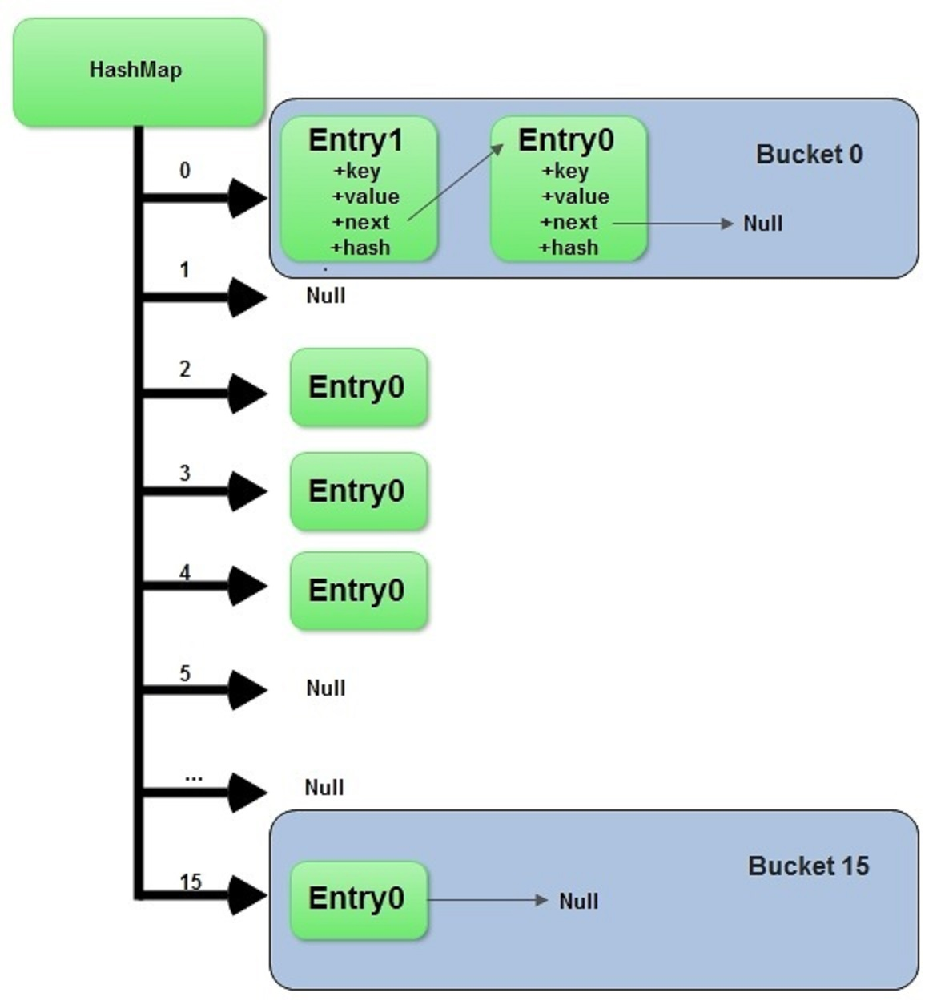
Hashmaps – How do they work?
Composed of an array of singly linked lists.
Each singly linked list is called a “Bucket”
Works on a Key/Value system
Key is what we identify the data by, value is what is associated with it.
Think of a dog care system.
E.g. the Key could be a Person object called Elliott
And the value could be a Dog object
mapName.put(elliottObject,dogObject);
These objects would then be mapped together.
So when we want to find out which dog is mine, we could retrieve that value by checking the key that is elliottObject
mapName.get(elliottObject); // would return dogObject
Notes:
When a used calls put(Key k , V value); or get(Object key)
The function computes the index of the bucket where the entry should be in
Then the function iterates through that buckets linked list and checks the hash against each item in there until it finds it, then returns the value.
The get function will return the value if the key is found
The put function will replace an existing entry with that key or create a new entry at the head of the list if not found.
The index (which bucket it will be in) is computed like so;
First it gets the hashcode of the key provided
Then it bitmasks the hashcode with the length (minus 1) of the array of linked lists, this operation ensures that the index cant be greater than the size of the array.
//takes the object in directly
static final int hash(Object key) {
int h;
return (key == null) ? 0 : (h = key.hashCode()) ^ (h >>> 16);
}
// the function that returns the index from the rehashed hash
static int indexFor(int h, int length) {
return h & (length-1);
}
It works with buckets
It computes where the object should go based upon a few things
Come out with one value
Effectively a hash
Hash can be decerpyted
Passwords are hashed
Not stored as plain text
Effectively a unique identifier – and from this identifier it know which bucket it needs to go into
What this means is that say we have lots of buckets of data
It will hash the data
Can go straight there
Depending on the hashing algorithm it know exactly where to go
It knows where to go in the hash map dependant on what you give it
Usual size is 16 buckets
Maps and array lists are comparable- they can be swapped but it might be that you are using the map in the wrong way
Specify that you are supposed to give a key then return the value
But this is not how you should be using the map
Key has to be unique
Values can be duplicated.
A set is a data structure, like an array, but cannot hold duplicates

Slide 76
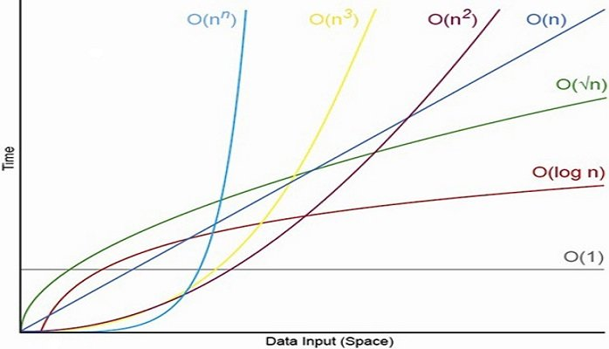
Big-O Notation
Notes:
Worst case scenario
Can be used to describe either the time required or the memory used
Log n Is that as the size increases the complexity decreases, good sorting algorithms operate with a (log n) complexity
http://bigocheatsheet.com/
Nn is recursion

Slide 77
Thank you for listening
Any questions?

